Slide 1
Cracking the code
Brooke Deck

Slide 2
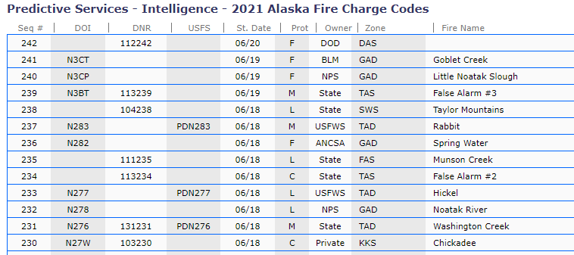
AICC Webpage

Slide 3
Prefixes based on Protection
PN - state protection with override of 1522
PD - BLM protection with override of 1522
P0 - USFS protection override of 1004 for Chugach
P0 - USFS protection override of 1005 for Tongass.

Slide 4
In WildCAD

Slide 5
In ifm

Slide 6
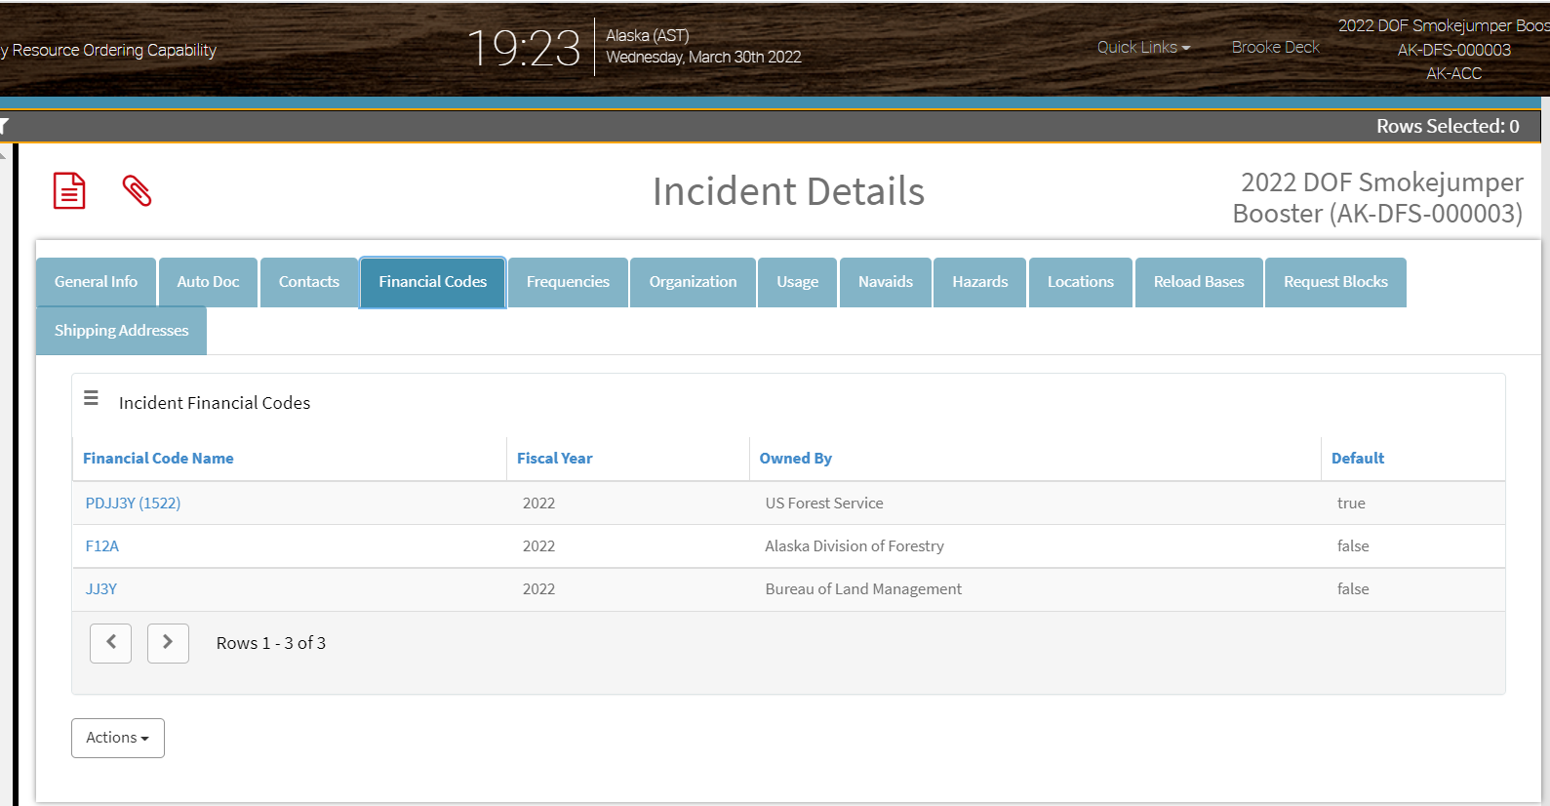
IROC

Slide 7
Have a great fire season!

